Slide 1
Employees performance scoreboard in excel
STUDENT NAME: M. Sujitha
REGISTER NO: 312204251
DEPARTMENT: b. Com (accounting and finance)
COLLEGE : Annai violet arts and science college

Slide 2
PROJECT TITLE
Employee Performance Scoreboard in excel.

Slide 3


AGENDA
Problem Statement
Project Overview
End Users
Our Solution and Proposition
Dataset Description
Modelling Approach
Results and Discussion
Conclusion
3/21/2024 Annual Review

Slide 4

PROBLEM STATEMENT
The company is experiencing challenges in effectively tracking and evaluating employee performance across various departments. The existing performance review process is manual, time-consuming, and prone to inconsistencies.

Slide 5

PROJECT OVERVIEW
The Employee Performance Scorecard in Excel aims to streamline and standardize the evaluation of employee performance by tracking key performance indicators (KPIs) such as productivity, quality, attendance, and teamwork. The scorecard will include automated calculations, customizable weighting of KPIs, and visual dashboards to generate real-time performance insights.
.

Slide 6

WHO ARE THE END USERS?
Managers
HR Personnel
Senior Management
Employees
Team Leads and supervisor
Senior executives

Slide 7

OUR SOLUTION AND ITS VALUE PROPOSITION
The Employee Performance Scorecard in Excel is a comprehensive tool designed to track, evaluate, and analyze employee performance using key performance indicators (KPIs). It provides an automated, easy-to-use platform for managers and HR teams to assess individual and team performance consistently across the organization.

Slide 8
Dataset description:
Employee Information:
Employee ID: Unique identifier for each employee.
Name: Full name of the employee.
Department: Department or team to which the employee belongs.
Position/Title: Job role or title of the employee.
Manager/Supervisor: Name of the employee's direct supervisor or manager.
Date of Hire: The date the employee joined the company.

Slide 9

THE "WOW" IN OUR SOLUTION
Dynamic charts and graphs provide a clear visual representation of progress, trends, and comparisons across time periods. Users can interact with the dashboard through drop-down filters, allowing quick selection by role, department, or performance period, offering tailored insights at a glance.
3/21/2024 Annual Review
9

Slide 10
MODELLING
An Employee Performance Scoreboard in Excel tracks metrics like attendance, sales, customer satisfaction, and task completion. It calculates weighted scores for each metric, sums them for an overall score, and uses conditional formatting to highlight performance levels (high, average, low). Graphs or dashboards can be added for visualization.
10

Slide 11
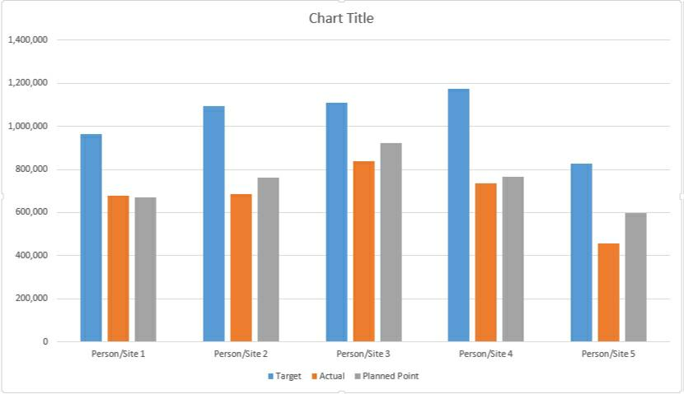
RESULTS
11

Slide 12
conclusion
In conclusion, an employee performance scoreboard in Excel provides a clear, quantifiable overview of individual and team performance. It enables easy tracking of key metrics, facilitates data-driven decisions, and fosters accountability. The customizable nature of Excel allows for real-time updates, ensuring timely performance reviews and goal setting.

